Slide 1

SubHunt : Enhancing Search Engine Relevance for Video Subtitles.
Team ID: T211026
Team Member :
Anushka Yeole (IN1240632) & Balaga Udaykiran (IN1240728)

Slide 2
Table of Contents :
Abstract
Introduction
Dataset Description
Methods & Algorithms
Project Analysis
Results
Screen Shots
Conclusions
Thank You

Slide 3
ABSTRACT
This project aims to enhance the search relevance for video subtitles, focusing on improving the accessibility of video content through advanced search engine algorithms. By leveraging natural language processing and machine learning techniques, we develop a comprehensive approach to retrieve subtitles based on user queries. The project compares keyword-based and semantic search engines, emphasizing the importance of understanding query context for improved relevance. Key steps include data preprocessing, text vectorization, document chunking, and cosine similarity calculation. Through experimentation and implementation, we aim to optimize search results, ultimately enhancing the user experience and accessibility of video content.

Slide 4
INTRODUCTION
In the digital era, access to relevant video content is crucial, and search engines play a pivotal role in facilitating this access. This project focuses on enhancing search engine capabilities for video subtitles, aiming to improve accessibility and relevance. By leveraging natural language processing (NLP) and machine learning (ML) techniques, we aim to develop an advanced search algorithm that efficiently retrieves subtitles based on user queries.
The project compares keyword-based and semantic search engines, emphasizing the importance of understanding query context. Through data preprocessing, text vectorization, document chunking, and cosine similarity calculation, we aim to optimize search results, ultimately improving the user experience when searching for video content.

Slide 5
DATASET DESCRIPTION
The dataset comprises a sample of 82,498 subtitle files obtained from opensubtitles.org. These subtitles predominantly cover movies and TV series released between 1990 and 2024. The dataset is stored in a database file named "eng_subtitles_database.db."
The database contains a single table named 'zipfiles' with three columns
num: A unique subtitle ID reference for opensubtitles.org, which serves as a primary key for each subtitle entry.
name: The filename of the subtitle file.
content: The subtitle files were compressed and stored as binary data using the 'latin-1' encoding.

Slide 6
METHODS & ALGORITHMS
In this project, we employed the Bidirectional Encoder Representations from Transformers (BERT), a state-of-the-art natural language processing (NLP) model, to create a semantic search engine for video subtitles. BERT has revolutionized the field of NLP by providing deep contextualized word representations, capturing bidirectional relationships between words in a sentence.
The process of creating a semantic search engine using BERT involves several steps:

Slide 7
Preprocessing:
Before feeding the text data into the BERT model, we performed preprocessing steps such as tokenization, lowercasing, removing timestamps and removing unused special characters. These steps ensure that the input data is in an indexed format suitable for BERT processing.
Sentence Embeddings:
BERT generates contextualized word embeddings for each word in a sentence. To obtain a fixed-size representation for the entire sentence, we utilized techniques such as pooling or taking the output of a specific layer of the BERT model. This process results in a dense vector representation, or embedding, capturing the semantic meaning of the given query.

Slide 8
3. Semantic Search:
Once we obtained sentence embeddings for both the subtitle documents and user queries, we computed the similarity between them using cosine similarity. Cosine similarity measures the cosine of the angle between two vectors and provides a metric of similarity between them. A higher cosine similarity score indicates greater semantic similarity between the two vectors.
4. Document Retrieval:
Based on the cosine similarity scores calculated between the user query embedding and the embeddings of subtitle documents, we retrieved the most relevant documents. Documents with high similarity scores are considered more relevant to the user query and returned as search results.

Slide 9
PROJECT ANALYSIS
Functionality:
The application successfully retrieves subtitles containing the user-provided query.
It leverages a BERT model for semantic similarity computation, enhancing search accuracy.
User Experience (UX):
The user interface features a simple search bar and clear search/clear buttons, ensuring ease of use.
Text highlighting aids in quickly identifying relevant information within retrieved subtitles.

Slide 10
3. Backend Implementation:
Flask framework powers the backend, offering a robust foundation for handling HTTP requests.
Utilization of SQLite database for subtitle storage ensures efficient data retrieval.
4. Performance and Scalability:
Caching mechanism improves performance by storing and retrieving previously searched results.
Room for optimization exists to handle larger datasets and enhance overall application scalability.

Slide 11
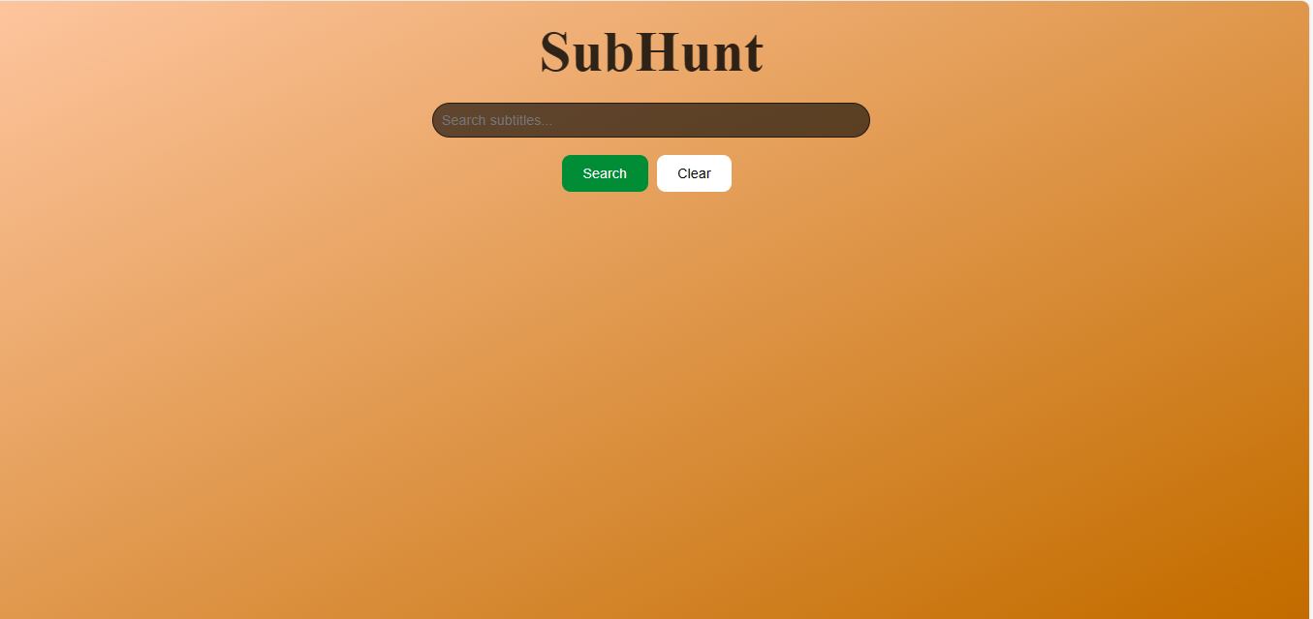
Interface :

Slide 12
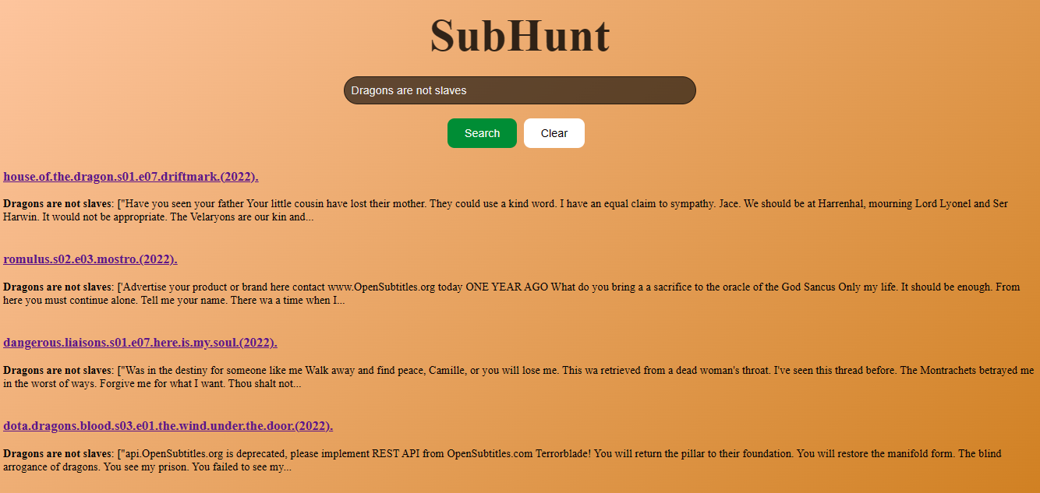
Query : Dragons are not slaves.

Slide 13
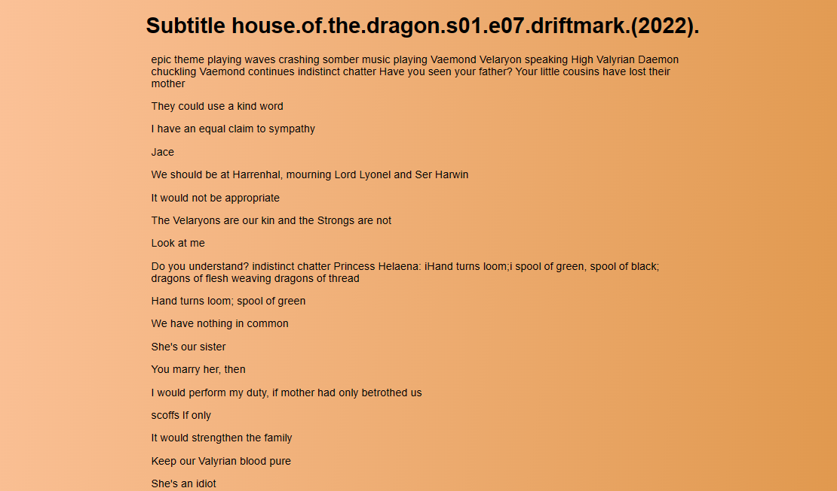

Slide 14
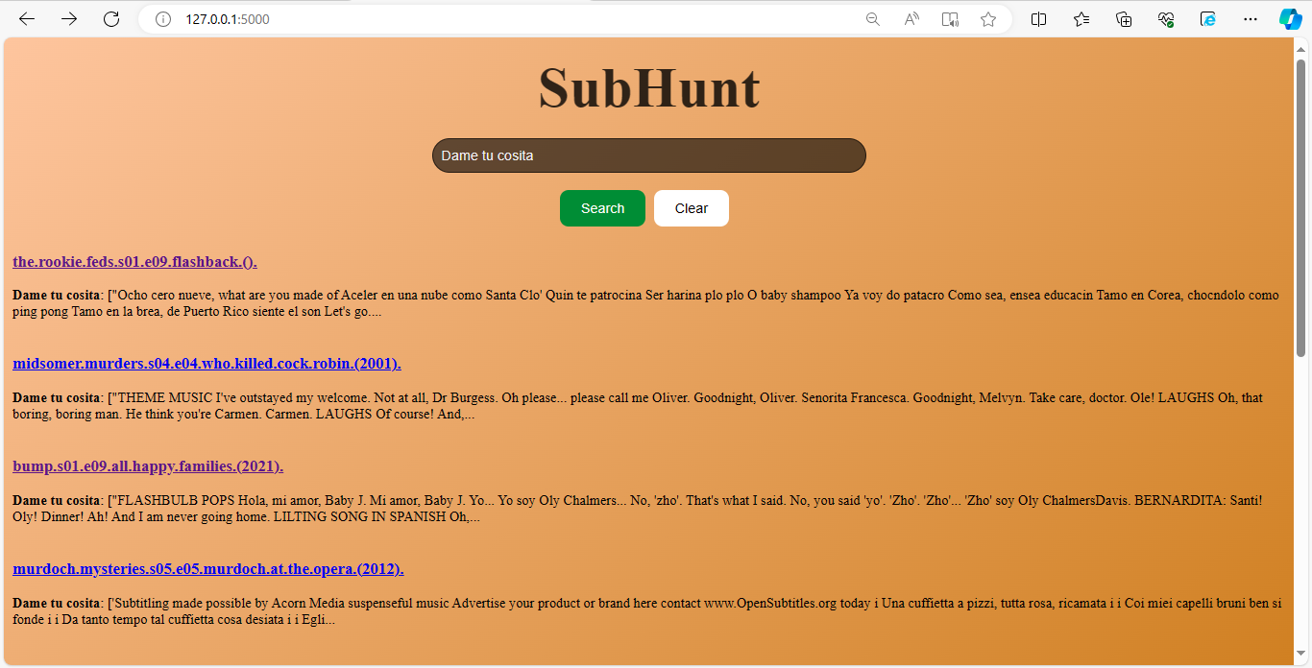
Query : Dame tu cosita.

Slide 15
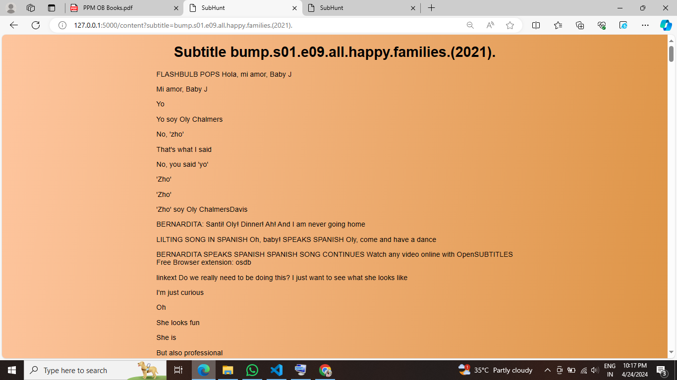

Slide 16
Conclusion :
Our project represents a pioneering effort in harnessing cutting-edge NLP techniques to revolutionize video content retrieval. By seamlessly integrating BERT-based semantic understanding and efficient document chunking, we've unlocked new possibilities for enhancing search relevance and accessibility. Despite challenges, including resource limitations, our semantic search engine showcases remarkable potential for reshaping how users interact with video content. As we continue to refine and optimize our approach, we're poised to set new standards in multimedia information retrieval, enriching the digital experience for users worldwide.

Slide 17


